Slide 1
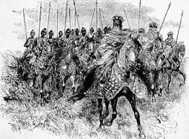
FAUX DEPART DE L’EMPEREUR DES MOSSI (MOGHO NABA)
MOSSI EMPEROR (MOGHO NABA)’s FALSE DEPARTURE
CHAQUE VENDREDI / EVERY FRIDAY

Slide 2
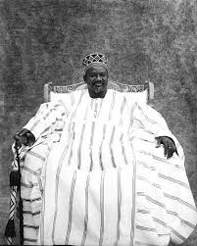
FAUX DEPART DE L’EMPEREUR DES MOSSI (MOGHO NABA)
MOSSI EMPEROR (MOGHO NABA)’s FALSE DEPARTURE
CHAQUE VENDREDI / EVERY FRIDAY

Slide 3

FAUX DEPART DE L’EMPEREUR DES MOSSI (MOGHO NABA)
MOSSI EMPEROR (MOGHO NABA)’s FALSE DEPARTURE
CHAQUE VENDREDI / EVERY FRIDAY

Slide 4

FAUX DEPART DE L’EMPEREUR DES MOSSI (MOGHO NABA)
MOSSI EMPEROR (MOGHO NABA)’s FALSE DEPARTURE
CHAQUE VENDREDI / EVERY FRIDAY

Slide 5
VISITES GUIDEES
GUIDED TOURS
RENSEIGNEMENTS & RESERVATION / INFORMATION & RESERVATION
+226 25 37 55 69
Email: residencelecailcedrat@gmail.com
Site: www.residencelecailcedrat.net
OUAGADOUGOU, BURKINA FASO

