Slide 1
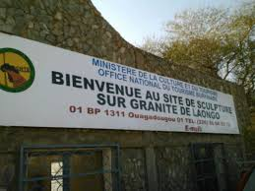
SITE DE SCULPTURE SUR GRANITE DE LAONGO
LAONGO GRANITE SCULPTURE SITE

Slide 2
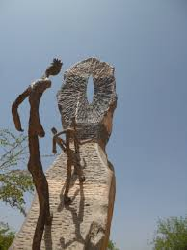
SITE DE SCULPTURE SUR GRANITE DE LAONGO
LAONGO GRANITE SCULPTURE SITE

Slide 3
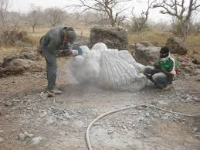
SITE DE SCULPTURE SUR GRANITE DE LAONGO
LAONGO GRANITE SCULPTURE SITE

Slide 4

SITE DE SCULPTURE SUR GRANITE DE LAONGO
LAONGO GRANITE SCULPTURE SITE

Slide 5
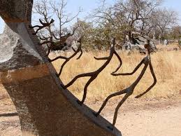
SITE DE SCULPTURE SUR GRANITE DE LAONGO
LAONGO GRANITE SCULPTURE SITE

Slide 6
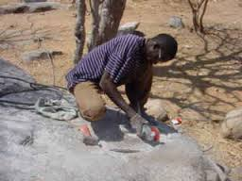
SITE DE SCULPTURE SUR GRANITE DE LAONGO
LAONGO GRANITE SCULPTURE SITE

Slide 7
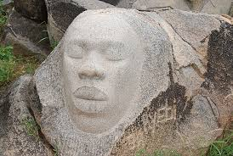
SITE DE SCULPTURE SUR GRANITE DE LAONGO
LAONGO GRANITE SCULPTURE SITE

Slide 8
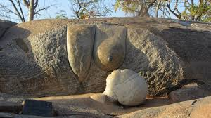
SITE DE SCULPTURE SUR GRANITE DE LAONGO
LAONGO GRANITE SCULPTURE SITE

Slide 9
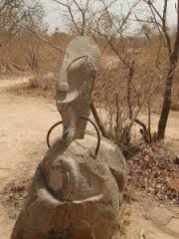
SITE DE SCULPTURE SUR GRANITE DE LAONGO
LAONGO GRANITE SCULPTURE SITE

Slide 10
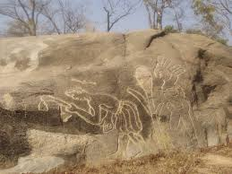
SITE DE SCULPTURE SUR GRANITE DE LAONGO
LAONGO GRANITE SCULPTURE SITE

Slide 11
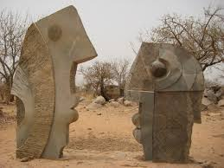
SITE DE SCULPTURE SUR GRANITE DE LAONGO
LAONGO GRANITE SCULPTURE SITE

Slide 12
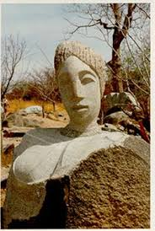
SITE DE SCULPTURE SUR GRANITE DE LAONGO
LAONGO GRANITE SCULPTURE SITE

Slide 13
VISITES GUIDEES
GUIDED TOURS
RENSEIGNEMENTS & RESERVATION / INFORMATION & RESERVATION
+226 25 37 55 69
Email: residencelecailcedrat@gmail.com
Site: www.residencelecailcedrat.net
OUAGADOUGOU, BURKINA FASO

