Slide 1
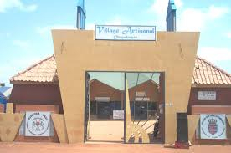
VILLAGE ARTISANAL DE OUAGADOUGOU
OUAGADOUGOU ARTS AND CRAFTS VILLAGE

Slide 2
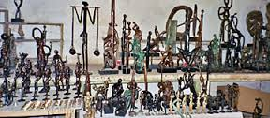
OBJETS D’ART
WORKS OF ART

Slide 3
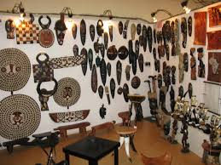
OBJETS D’ART
WORKS OF ART

Slide 4

OBJETS D’ART
WORKS OF ART

Slide 5
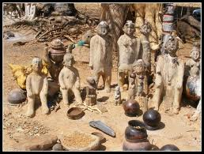
MOULAGE A CIRE PERDU
LOST-WAX CASTING

Slide 6
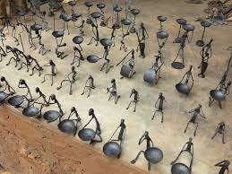
OBJETS D’ART
WORKS OF ART

Slide 7
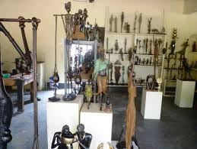
OBJETS D’ART
WORKS OF ART

Slide 8
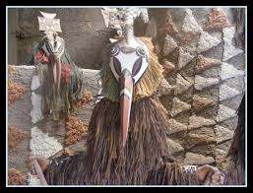
OBJETS D’ART
WORKS OF ART

Slide 9
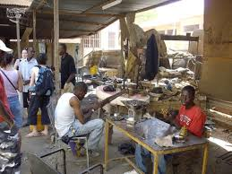
ARTISANS AU TRAVAIL
CRAFTSMEN AT WORK

Slide 10
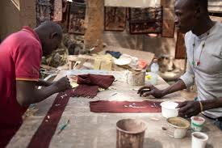
ARTISANS AU TRAVAIL
CRAFTSMEN AT WORK

Slide 11
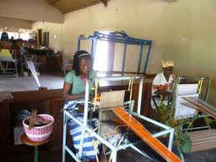
METIER A TISSER
WEAVING LOOM

Slide 12
VISITES GUIDEES
GUIDED TOURS
RENSEIGNEMENTS & RESERVATION / INFORMATION & RESERVATION
+226 25 37 55 69
Email: residencelecailcedrat@gmail.com
Site: www.residencelecailcedrat.net
OUAGADOUGOU, BURKINA FASO

