Slide 1
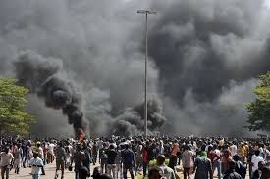
REVOLUTION BURKINABE DES 30 ET 31 OCTOBRE
BURKINABE REVOLUTION OF 30th AND 31st OCTOBER

Slide 2
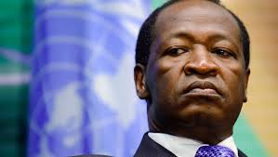
INTENTION DE DEMEURER AU POUVOIR EN AMENDANT LA CONSTITUTION
INTENTION TO STAY IN POWER BY AMENDING THE CONSTITUTION

Slide 3
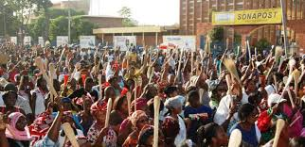
MANIFESTANTES OPPOSES A LA MODIFICATION DE LA CONSTITUTION MUNIES DE LEUR SPATULES
ANTI-CONSTITUTIONAL AMENDMENT FEMALE DEMONSTRATORS WITH THEIR SPATULAS

Slide 4
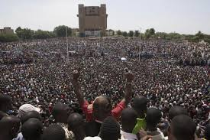
MEGA RASSEMBLEMENT CONTRE LA MODIFICATION DE LA CONSTITUTION
ANTI-CONSTITUTIONAL AMENDMENT MEGA RALLY
PLACE DE LA REVOLUTION/REVOLUTION SQUARE - OUAGADOUGOU

Slide 5
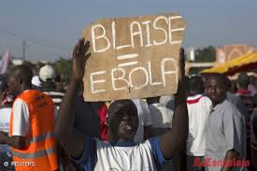
MANIFESTANTS OPPOSES A L’AMENDEMENT DE LA CONSTITUTION
ANTI-CONTITUTIONAL AMENDMENT DEMONSTRATORS

Slide 6
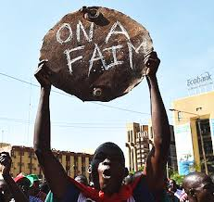
MANIFESTANTS OPPOSES A L’AMENDEMENT DE LA CONSTITUTION
ANTI-CONTITUTIONAL AMENDMENT DEMONSTRATORS

Slide 7
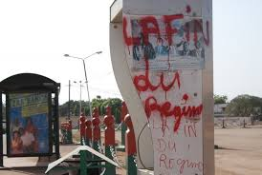
GRAFFITIS CONTRE LE REGIME DE COMPAORE
GRAFFITIS AGAINST COMPAORE’s REGIME

Slide 8
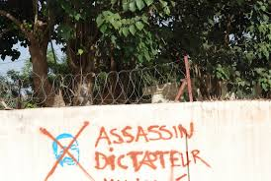
GRAFFITIS CONTRE LE REGIME DE COMPAORE
GRAFFITIS AGAINST COMPAORE’s REGIME

Slide 9
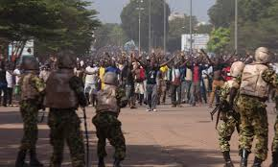
LE PEUPLE EN ROUTE POUR L’ASSEMBLEE NATIONALE POUR ARRETER LA MODIFICATION DE LA CONSTITUTION
THE PEOPLE HEADING FOR PARLIAMENT TO STOP THE CONSTITUTIONAL AMENDMENT
30 OCTOBRE/OCTOBER 2014

Slide 10
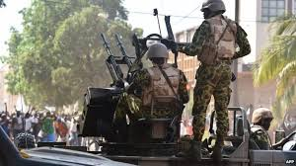
LE PEUPLE EN ROUTE POUR L’ASSEMBLEE NATIONALE POUR ARRETER LA MODIFICATION DE LA CONSTITUTION
THE PEOPLE HEADING FOR PARLIAMENT TO STOP THE CONSTITUTIONAL AMENDMENT
30 OCTOBRE/OCTOBER 2014

Slide 11
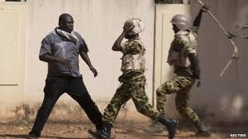
CONFRONTATION ENTRE LES FORCES DE SECURITE ET UN MANIFESTANT
SHOWDOWN BETWEEN SECURITY FORCES AND DEMONSTRATOR

Slide 12
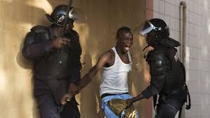
CONFRONTATION ENTRE LES FORCES DE SECURITE ET UN MANIFESTANT
SHOWDOWN BETWEEN SECURITY FORCES AND DEMONSTRATOR

Slide 13
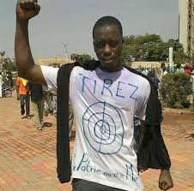
UN MANIFESTANT
A DEMONSTRATOR

Slide 14
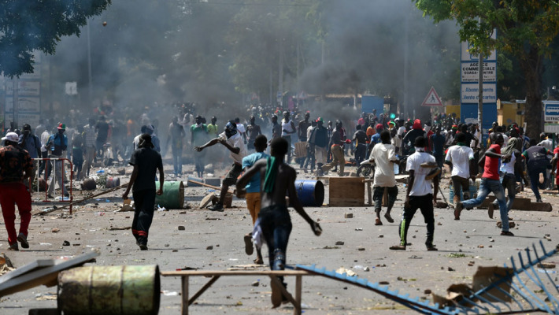
MANIFESTANTS EN ACTION
DEMONSTRATORS IN ACTION

Slide 15
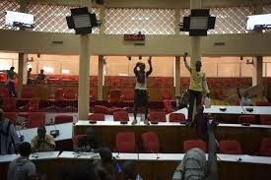
INCURSION DES MANIFESTANTS DANS L’ASSEMBLEE NATIONALE
INCURSION OF DEMONSTRATORS INTO PARLIAMENT

Slide 16
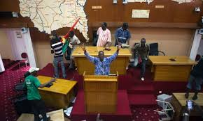
DEBANDADE DES DEPUTES
STAMPEDE AMONG MPs

Slide 17
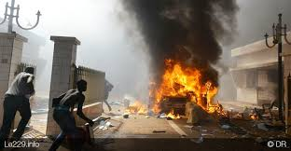
INCENDIE DE L’ASSEMBLEE NATIONALE
TORCHING OF PARLIAMENT

Slide 18
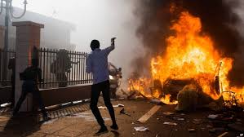
INCENDIE DE L’ASSEMBLEE NATIONALE
TORCHING OF PARLIAMENT

Slide 19
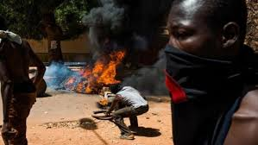
INCENDIE DE L’ASSEMBLEE NATIONALE
TORCHING OF PARLIAMENT

Slide 20
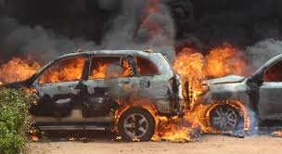
INCENDIE DE L’ASSEMBLEE NATIONALE
TORCHING OF PARLIAMENT

Slide 21
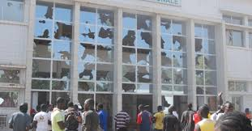
ASSEMBLEE NATIONALE APRES LE PASSAGE DES MANIFESTANTS
PARLIAMENT AFTER DEMONSTRATORS’ INCURSION

Slide 22
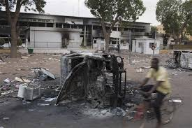
ASSEMBLEE NATIONALE APRES LE PASSAGE DES MANIFESTANTS
PARLIAMENT AFTER DEMONSTRATORS’ INCURSION

Slide 23
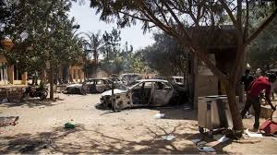
ASSEMBLEE NATIONALE APRES LE PASSAGE DES MANIFESTANTS
PARLIAMENT AFTER DEMONSTRATORS’ INCURSION

Slide 24
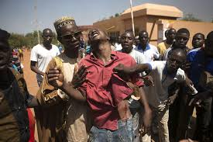
REPRESSION SANGLANTE
BLOODY REPRESSION

Slide 25
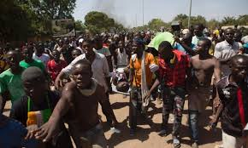
REPRESSION SANGLANTE
BLOODY REPRESSION

Slide 26
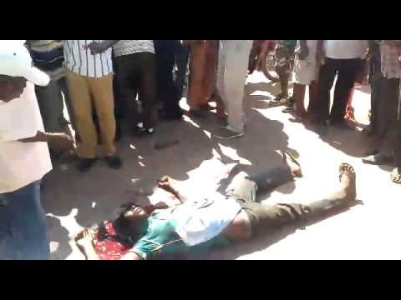
REPRESSION SANGLANTE
BLOODY REPRESSION

Slide 27
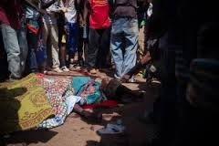
REPRESSION SANGLANTE
BLOODY REPRESSION

Slide 28
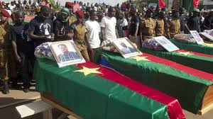
MARTYRS DE LA REVOLUTION BURKINABE
MARTYRS TO THE CAUSE OF BURKINA FASO’s REVOLUTION

Slide 29
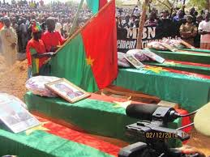
MARTYRS DE LA REVOLUTION BURKINABE
MARTYRS TO THE CAUSE OF BURKINA FASO’s REVOLUTION

Slide 30
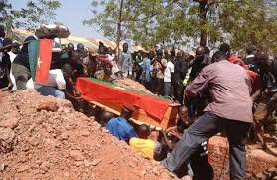
MARTYRS DE LA REVOLUTION BURKINABE
MARTYRS TO THE CAUSE OF BURKINA FASO’s REVOLUTION

Slide 31
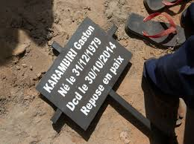
MARTYRS DE LA REVOLUTION BURKINABE
MARTYRS TO THE CAUSE OF BURKINA FASO’s REVOLUTION

Slide 32

TRIBUTE TO THE HEROS OF THE REVOLUTION WHO DIED FOR THEIR FATHERLAND ON 30th AND 31st OCTOBER 2014
IN BURKINA FASO

Slide 33
VISITES GUIDEES
GUIDED TOURS
RENSEIGNEMENTS & RESERVATION / INFORMATION & RESERVATION
+226 25 37 55 69
Email: residencelecailcedrat@gmail.com
Site: www.residencelecailcedrat.net
OUAGADOUGOU, BURKINA FASO

